Slide 1
ERROR DETECTION AND CORRECTION
ERROR DETECTION AND CORRECTION
Error Detection and Correction (Parity, Checksums, and CRC)
CSMA Networks
Circuit and Packet Switching

Slide 2
BASIC CONCEPTS
Errors are introduced in the data bits during their transmission across a data network. The link-layer hardware in a receiving node can incorrectly decide that a bit in a frame is zero when it was transmitted as a one, and vice versa.
Error sources include interference, distortion, and attenuation.
Many link-layer protocols provide a mechanism to detect such bit errors. In digital transmission systems, an error occurs when a bit is altered between transmission and reception; that is, a binary 1 is transmitted and a binary 0 is received, or a binary 0 is transmitted and a binary 1 is received.
Two general types of errors can occur: single-bit errors and burst errors.
For reliable communication, errors must be detected and corrected. Error detection and correction are implemented either at the data link layer or the transport layer of the OSI model.

Slide 3
TYPE OF ERRORS
Single-bit error: A single-bit error is an isolated error condition that alters one bit but does not affect nearby bits. Only 1 bit in the data unit (packet, frame, cell) has changed. Either from 1 to 0 or 0 to 1.
Figure 1: Single bit Error

Slide 4
TYPE OF ERRORS
Burst Error: When two or more consecutive bits in the data unit have changed (from 1 to 0 or from 0 to 1).
The last erroneous bit in the burst and the first erroneous bit in the following burst are accordingly separated by x correct bits or more.
Figure 2: Burst Error

Slide 5
TYPE OF ERRORS
Burst errors do not necessarily mean that the errors occur in consecutive bits
Multiple-Bit Error: when two or more nonconsecutive bits in the data unit have changed
Figure 3: Burst Error

Slide 6
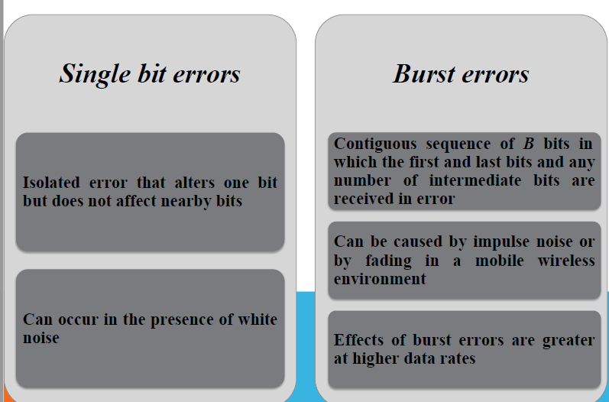
TYPE OF ERRORS

Slide 7
ERROR DETECTION/CORRECTION
Error control involves two basic steps, error detection, and error correction. The content errors are detected by introducing additional check bits in a block of the data bits. The sender encodes the check bits in such a way that the receiver can be able to detect the content errors. There are coding schemes that enable the receiver to correct the error. Alternatively, the receiver simply requests the sender for retransmission of the data block whenever it detects errors.
Error detection in the link layer is usually more sophisticated and is implemented in hardware. Error correction is similar to error detection, except that a receiver not only detects when bit errors have occurred in the frame but also determines exactly where in the frame the errors have occurred (and then corrects these errors).

Slide 8
ERROR DETECTION/CORRECTION
Error detection and correction techniques allow the receiver to sometimes, but not always, detect that bit errors have occurred. Even with the use of error detection bits, there may still be undetected bit errors; that is, the receiver may be unaware that the received information contains bit errors.
As a consequence, the receiver might deliver a corrupted datagram to the network layer, or be unaware that the contents of a field in the frame’s header have been corrupted. We thus want to choose an error-detection scheme that keeps the probability of such occurrences small.

Slide 9
ERROR DETECTION/CORRECTION
REDUNDANCY:
To detect or correct errors, we need to send extra (redundant) bits of data. The receiver will be able to detect or correct the error using the extra information.
Detection
Looking at the existence of any error, as YES or NO.
Retransmission if YES. Automatic repeat request (ARQ)
Correction
Looking at both the number of errors and the location of the errors in a message.
Forward error correction. (FEC)

Slide 10
ERROR DETECTION/CORRECTION
Figure 4: Error Detection and Correction

Slide 11
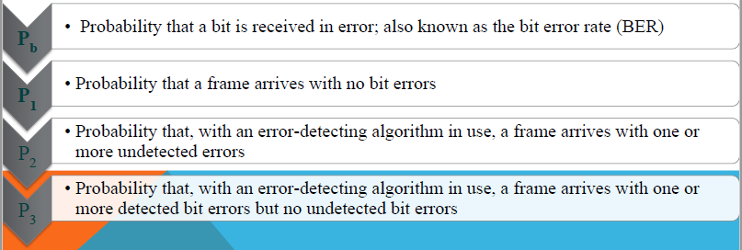
ERROR DETECTION
Regardless of the design of the transmission system, there will be errors, resulting in the change of one or more bits in a transmitted frame.
Frames: Data transmitted as one or more contiguous sequences of bits.

Slide 12
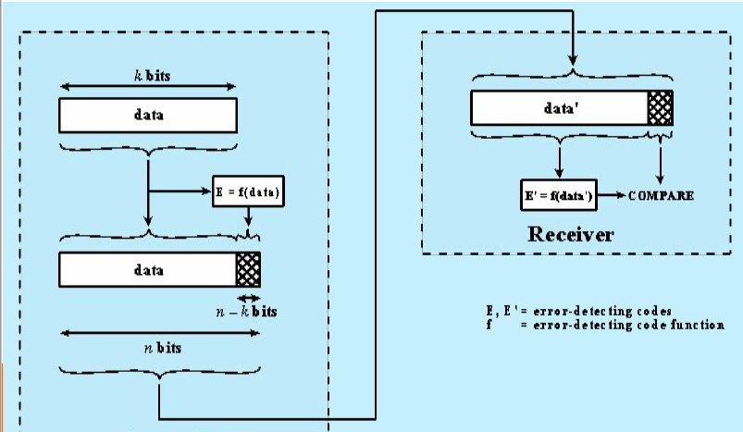
ERROR DETECTION PROCESS
Figure 5: Error Detection Process

Slide 13
ERROR DETECTION METHODS
Let’s now examine three techniques for detecting errors in the transmitted data.
parity checks (to illustrate the basic ideas behind error detection and correction),
checksum methods (which are more typically used in the transport layer)
cyclic redundancy checks (which are more typically used in the link layer in an adapter).
Error detection is carried out by adding check bits to the data word in each of the above three methods. The check bits are called parity bits, checksum bits, or CRC bits depending on the method used to generate them. Each method has its advantages and limitations.
Figure 6: Detection Method

Slide 14
PARITY CHECK
Perhaps the simplest form of error detection is the use of a single parity bit. In the parity check, an additional bit called parity bit is added to each data word. The additional bit is so chosen that the weight of the codeword thus formed is either even (even parity) or odd (odd parity). All the codewords of a code set have the same parity (either odd or even) which is decided in advance.
In an even parity scheme, the sender simply includes one additional bit and chooses its value such that the total number of 1s in the d+1 bits (the original information plus a parity bit) is even. For odd parity schemes, the parity bit value is chosen such that there is an odd number of 1s.

Slide 15
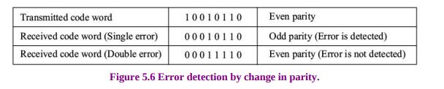
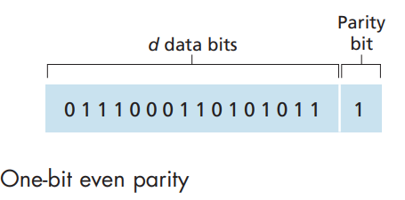
PARITY CHECK
When a single error or an odd number of errors occur during transmission, the parity of the code word changes as shown in Figure 7. The parity of the code word is checked at the receiving end and violation of the parity rule indicates errors somewhere in the code word.
Receiver operation is also simple with a single parity bit. The receiver needs only to count the number of 1s in the received d+1 bits. If an odd number of 1 valued bits are found with an even parity scheme, the receiver knows that at least one bit error has occurred. More precisely, it knows that some odd number of bit errors have occurred.
But what happens if an even number of bit errors occur? You should convince yourself that this would result in an undetected error. If the probability of bit errors is small and errors can be assumed to occur independently from one bit to the next, the probability of multiple bit errors in a packet would be extremely small.
Figure 7: Error Detection by Change in Parity

Slide 16
PARITY CHECK
Note that double or any even number of errors will go undetected because the resulting parity of the code word will not change. Thus, a simple parity-checking method has its limitations.
It is not suitable for multiple errors. To keep the possibility of occurrence of multiple errors low, the size of the data word is usually restricted to a single byte.
Parity checking does not reveal the location of the erroneous bit. The received code word with an error is always at an equal distance from two valid code words. Therefore, errors cannot be corrected by the parity checking method.
The main advantage of using parity is that we can generate the parity without the need for additional storage or computational overhead.

Slide 17
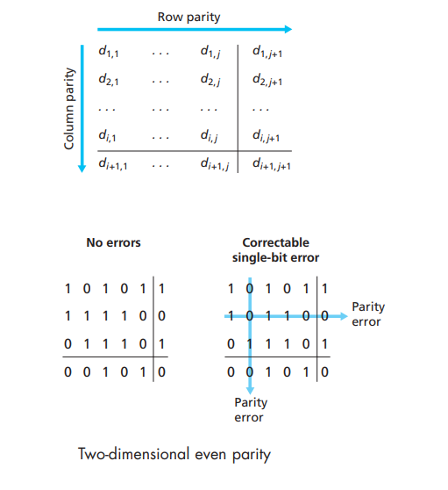
TWO DIMENTIONSL EVEN PARITY SCHEME
Suppose now that a single-bit error occurs in the original d bits of information. With this two-dimensional parity scheme, the parity of both the column and the row containing the flipped bit will be in error. The receiver can thus not only detect the fact that a single-bit error has occurred but can use the column and row indices of the column and row with parity errors to identify the bit that was corrupted and correct that error! Figure 8 shows an example in which the 1valued bit in position (2,2) is corrupted and switched to a 0. An error that is both detectable and correctable at the receiver. Although our discussion has focused on the original d bits of information, a single error in the parity bits themselves is also detectable and correctable. Two-dimensional parity can also detect (but not correct!) any combination of two errors in a packet.
Figure 8: Two-dimensional Even Parity

Slide 18
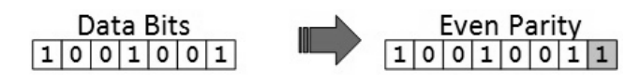
PARITY CHECK
Consider a code in which a single parity bit is appended to the data. The parity bit is chosen so that the number of 1 bit in the code word is even or odd. For example, when 1011010 is sent in even parity, a bit is added to the end to make it 10110100. With odd parity 1011010 becomes 10110101
The receiver simply counts the number of 1s in a frame. If the count of 1s is even and even parity is used, the frame is considered to be not-corrupted and is accepted. If the count of 1s is odd and odd parity is used, the frame is still not corrupted. If a single bit flips in transit, the receiver can detect it by counting the number of 1s. But when more than one bits are erroneous, then it is very hard for the receiver to detect the error.

Slide 19
PARITY CHECK
Note: A parity bit is a single bit added to the end of every data unit so that the total number of 1s (including the parity bit) becomes even for an even-parity check or odd for an odd-parity check Even number of bit errors go undetected thus not so useful.

Slide 20
PARITY CHECK
Typically, even parity is used for synchronous transmission and odd parity for asynchronous transmission.
The use of the parity bit is not foolproof, as noise impulses are often long enough to destroy more than one bit, particularly at high data rates.
If any even number of bits are inverted due to an error, an undetected error occurs
Figure 6: Parity Check

Slide 21
CHECKSUM
Used by the higher layer protocols. It is based on the concept of redundancy (vertical redundancy check (VRC), longitudinal redundancy check (LRC), Cyclic Redundancy Check (CRC)….)
Figure 7: Checksum Generator

Slide 22
CHECKSUM
Checksum operation: Perform a checksum on the data to be transmitted
Checksum value appended with the message to be transmitted to the receiver

Slide 23
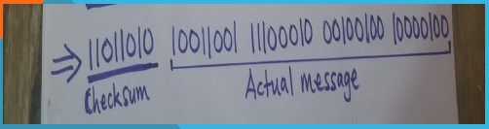
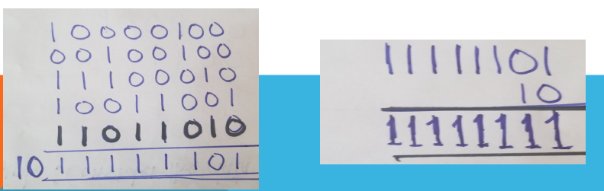
CHECKSUM
Checksum operation at the receiver
TRY
10101010 11001100 10001000

Slide 24
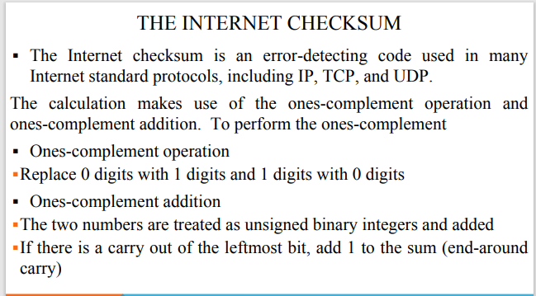

Slide 25
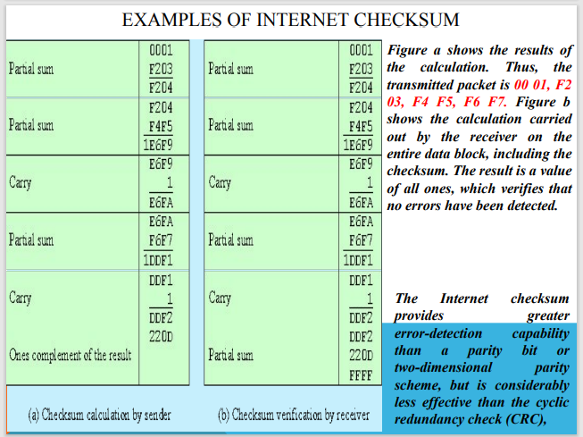

Slide 26
CYCLIC REDUNDANCY CHECK (CRC)
CRC is a different approach to detect if the received frame contains valid data. This technique involves binary division of the data bits being sent. The divisor is generated using polynomials. The sender performs a division operation on the bits being sent and calculates the remainder. Before sending the actual bits, the sender adds the remainder at the end of the actual bits. Actual data bits plus the remainder is called a codeword. The sender transmits data bits as codewords.
At the other end, the receiver performs division operations on codewords using the same CRC divisor. If the remainder contains all zeros the data bits are accepted, otherwise it is considered as there is some data corruption that occurred in transit.
Cyclic Redundancy Check (CRC) Cyclic redundancy check codes are very powerful and are now almost universally employed. These codes provide a better measure of protection at the lower level of redundancy and can be fairly easily implemented using shift registers or software.

Slide 27
CYCLIC REDUNDANCY CHECK (CRC)
This procedure can be stated in three equivalent ways: modulo 2 arithmetic, polynomials, and digital logic.
Modulo 2 arithmetic:
Uses binary addition with no carries, which is just the exclusive OR (XOR) operation. Binary subtraction with no carries is also interpreted as the XOR operation.
Polynomials:
Express all values as polynomials in a dummy variable X, with binary coefficients
Coefficients correspond to the bits in the binary number
Digital logic:
Dividing circuit consisting of XOR gates and a shift register
Shift register is a string of 1-bit storage devices
Each device has an output line, which indicates the value currently stored, and an input line
At discrete time instants, known as clock times, the value in the storage device is replaced by the value indicated by its input line
The entire register is clocked simultaneously, causing a 1-bit shift along the entire register

Slide 28
CYCLIC REDUNDANCY CHECK (CRC)
It is One of the most common and powerful error-detecting codes.
Given a k-bit block of bits, the transmitter generates an (n–k) bit frame check sequence (FCS) which is exactly divisible by some predetermined number.
The receiver divides the incoming frame by that number. If there is no remainder, assume there is no error.
Figure 9: Cyclic Redundancy Check

Slide 29
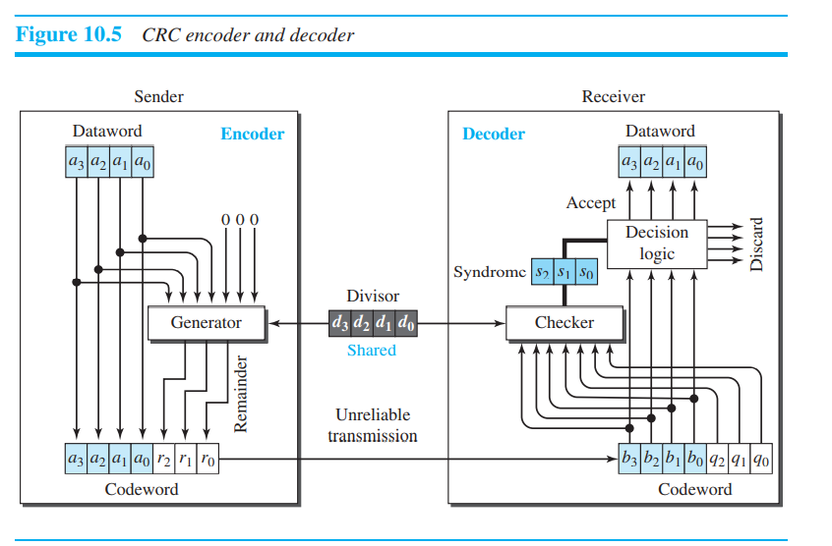
CYCLIC REDUNDANCY CHECK
In the encoder, the dataword has k bits (4 here); the codeword has n bits (7 here).
The size of the dataword is augmented by adding n-k (3 here) 0s to the right-hand side of the word.
The n-bit result is fed into the generator. The generator uses a divisor of size n-k+1 (4 here), predefined and agreed upon.
The generator divides the augmented dataword by the divisor (modulo-2 division). The quotient of the division is discarded; the remainder (r₂r₁r₀) is appended to the dataword to create the codeword.
The decoder receives the codeword (possibly corrupted in transition).
A copy of all n bits is fed to the checker, which is a replica of the generator.
The remainder produced by the checker is a syndrome of n-k (3 here) bits, which is fed to the decision logic analyzer.
The analyzer has a simple function. If the syndrome bits are all 0s, the 4 leftmost bits of the codeword are accepted as the dataword (interpreted as no error); otherwise, the 4 bits are discarded (error).
Figure 10: CRC Encoder and Decoder

Slide 30
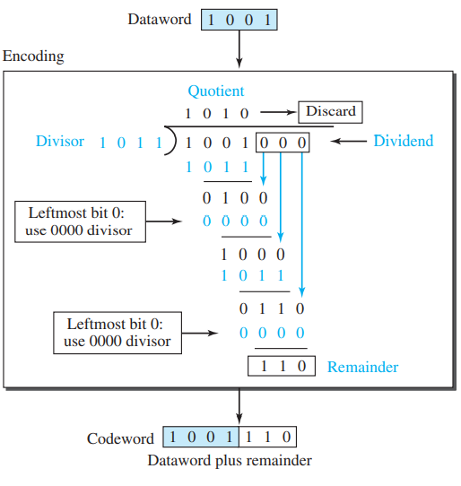
ENCODER
The encoder takes a dataword and augments it with n-k number of 0s. It then divides the augmented dataword by the divisor, as shown below:
The process of modulo-2 binary division is the same as the familiar division process we use for decimal numbers.
However, addition and subtraction, in this case, are the same; we use the XOR operation to do both.
As in the decimal division, the process is done step by step. In each step, a copy of the divisor is XORed with the 4 bits of the dividend.
The result of the XOR operation (remainder) is 3 bits (in this case), which is used for the next step after 1 extra bit is pulled down to make it 4 bits long.
There is one important point we need to remember in this type of division. If the leftmost bit of the dividend (or the part used in each step) is 0, the step cannot use the regular divisor; we need to use an all-0s divisor. When there are no bits left to pull down, we have a result. The 3-bit remainder forms the check bits (r₂r₁ , and r₀).
They are appended to the dataword to create the codeword.
Figure 11: Division in CRC Encoder

Slide 31
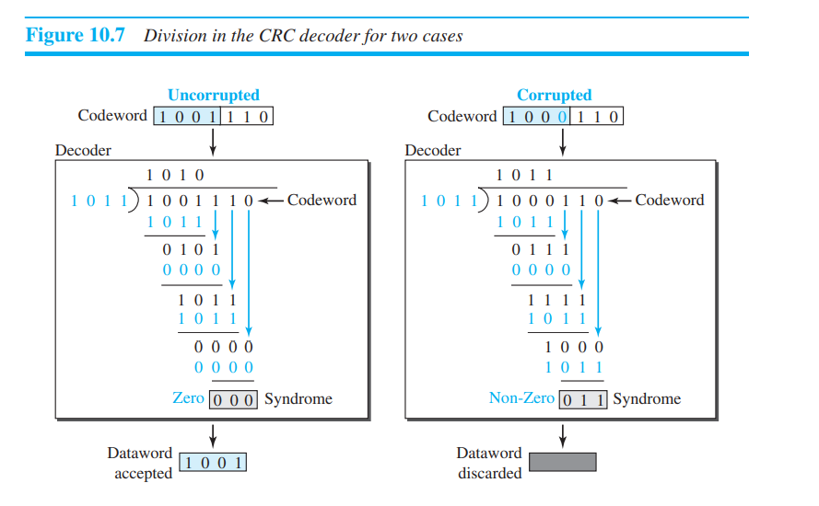
DECODER
The codeword can change during transmission.
The divisor 1011 was chosen based on the expectation we have from the code.
The decoder does the same division process as the encoder.
The remainder of the division is the syndrome. If the syndrome is all 0s, there is no error with a high probability; the dataword is separated from the received codeword and accepted.
Otherwise, everything is discarded. Figure 12 shows two cases: The left-hand figure shows the value of the syndrome when no error has occurred; the syndrome is 000.
The right-hand part of the figure shows the case in which there is a single error. The syndrome is not all 0s (it is 011).
Figure 12: Division in CRC Decoder for Two Cases

Slide 32
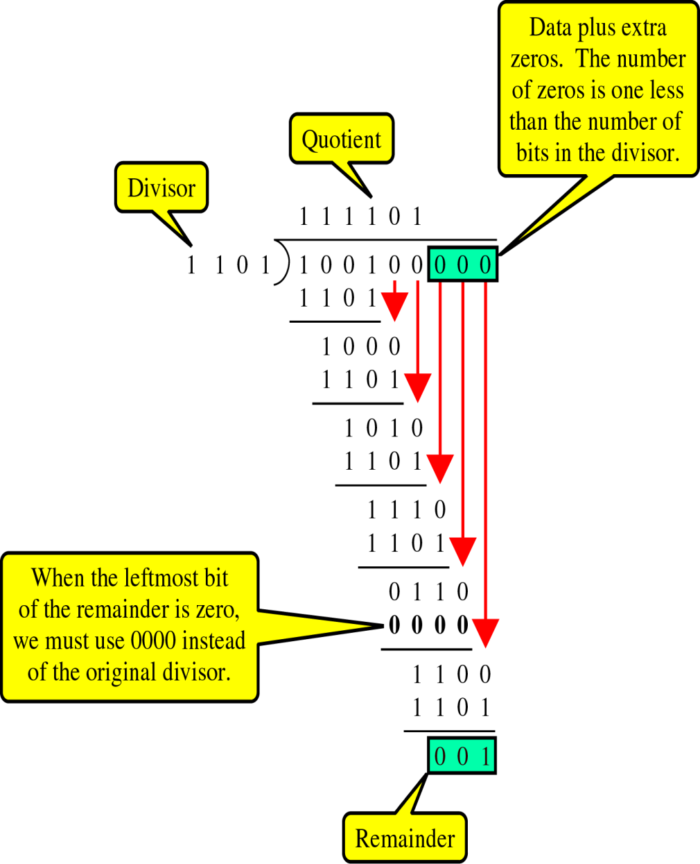
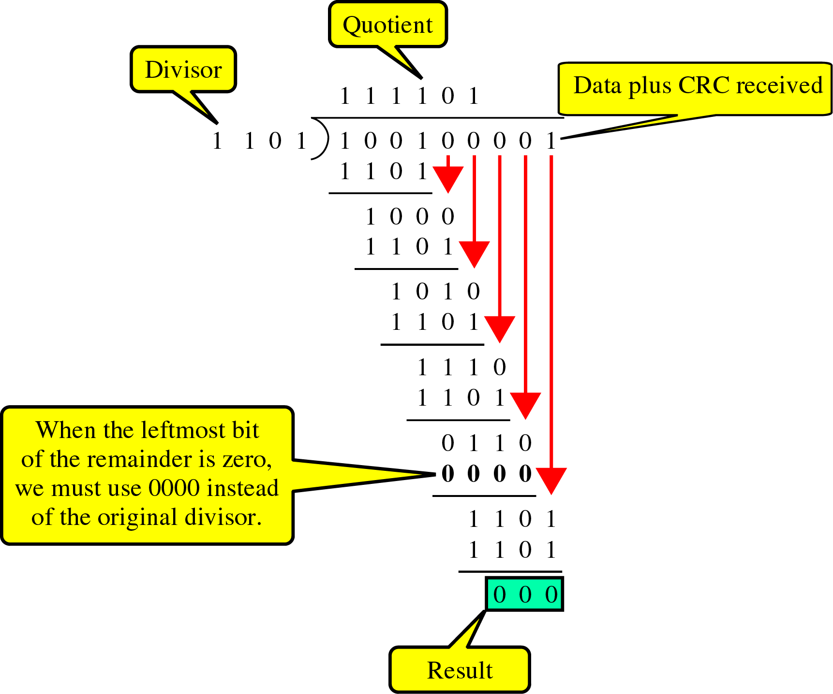
DIVISION IN CRC ENCODER
CRC generator: uses modular-2 division.
Binary Division
in a
CRC Generator

Slide 33
HAMMING CODE
The number of bit positions in which two codewords differ is called the Hamming distance (Hamming, 1950). Its significance is that if two codewords are a Hamming distance d apart, it will require d single-bit errors to convert one into the other.
The error-detecting and error-correcting properties of a code depend on its Hamming distance. To detect d errors, you need a distance d+1 code because with such a code there is no way that d single-bit errors can change a valid codeword into another valid codeword. When the receiver sees an invalid codeword, it can tell that a transmission error has occurred. Similarly, to correct d errors, you need a distance 2d+1 code because that way the legal codewords are so far apart that even with d changes, the original codeword is still closer than any other codeword, so it can be uniquely determined.

Slide 34
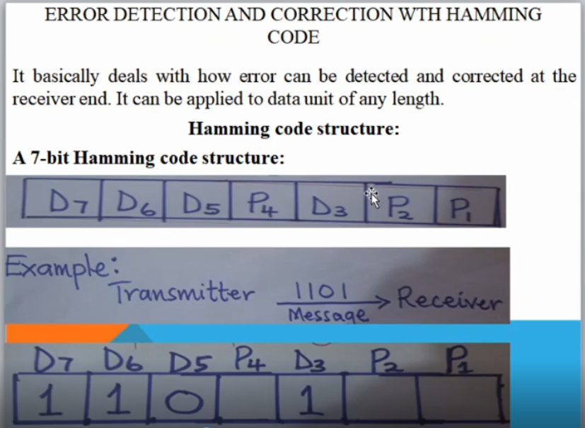

Slide 35
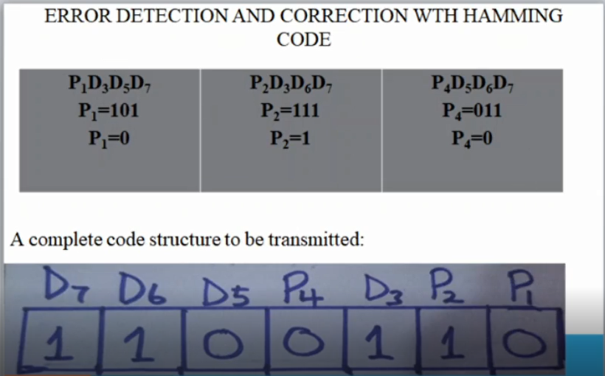

Slide 36
ERROR CORRECTION
After an error is detected, there are two approaches to correction of errors:
Reverse Error Correction (REC)
Forward Error Correction (FEC).
In the first approach, the receiver requests for retransmission of the codeword whenever it detects an error. If there is no error, the receiver returns an acknowledgment for the received codewords. Reverse error correction methods are extensively used in data networks. But these methods require the following conditions for their efficiency:
There should be a return channel from receiver to sender. The return channel should have a low error rate, otherwise, the retransmission requests and acknowledgments may be lost.
High transmission time of onward and return channels imposes memory and throughput constraints as the code words must be stored by the sender till they are acknowledged.

Slide 37
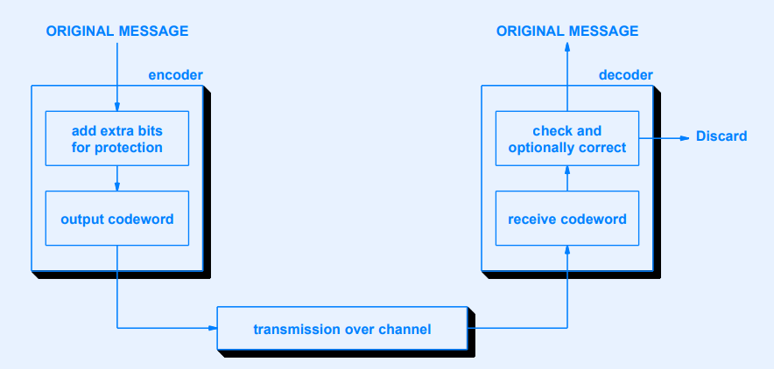
ERROR CORRECTION
In the second approach, the code is so designed that it is possible for the receiver to detect and correct the errors as well. The receiver locates the errors by analyzing the received code word and reverses the erroneous bits.
Concept Of Forward Error Correction (FEC)
Figure 13: Forward Error Correction

Slide 38
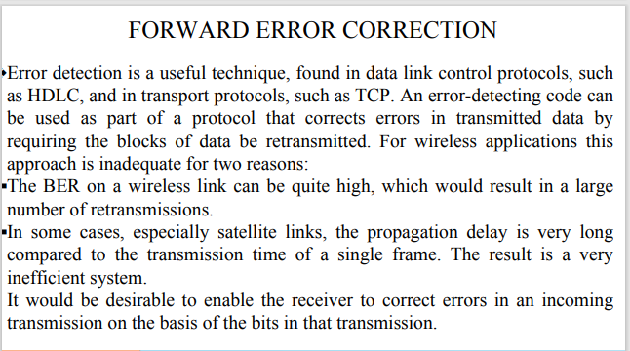

Slide 39
